Slide 1
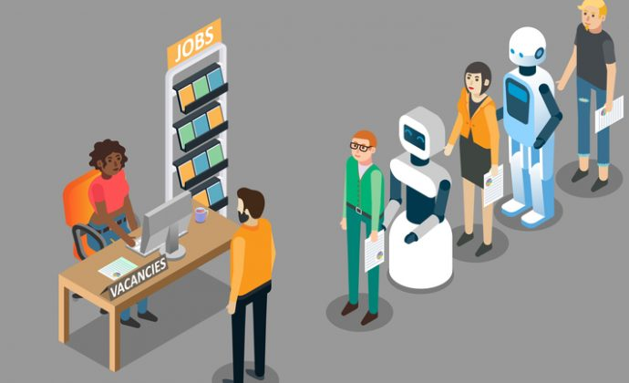
What is AI, and how will it change society ?

Slide 2
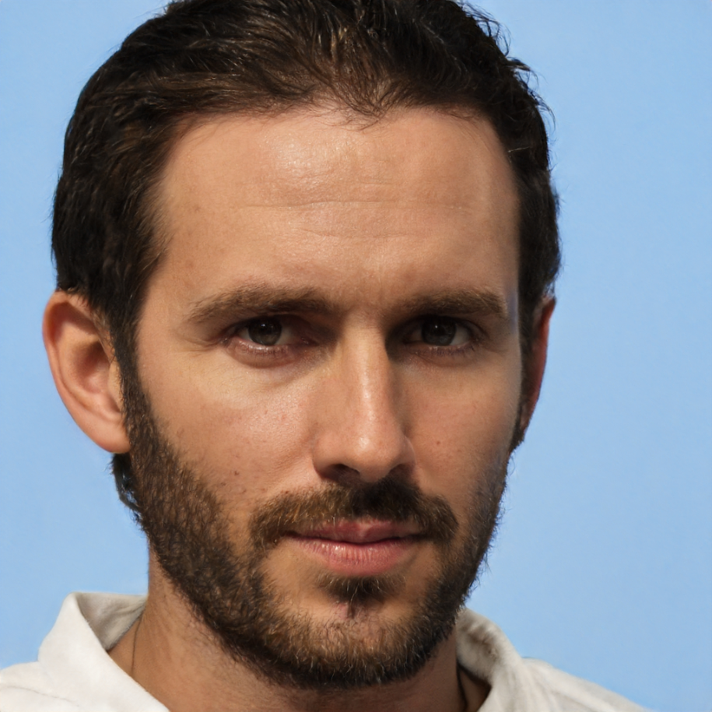


Slide 3
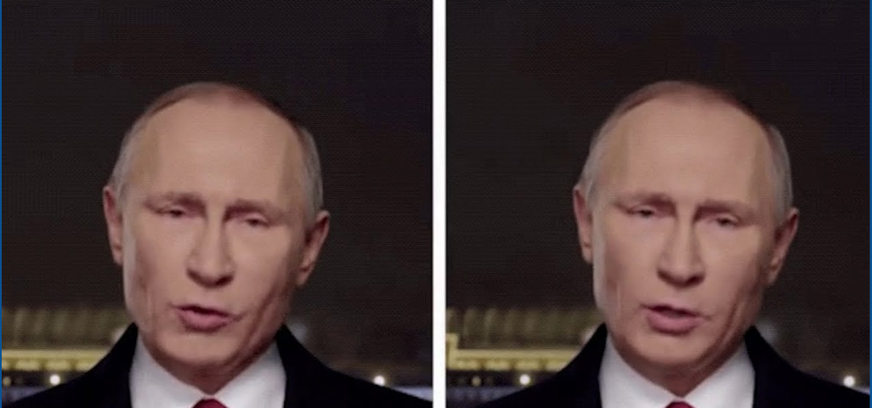
left real

Slide 4

Scope
Introduction
History of AI and idea of technological progress
AI Landscape
AI today
Risks of AI

Slide 5

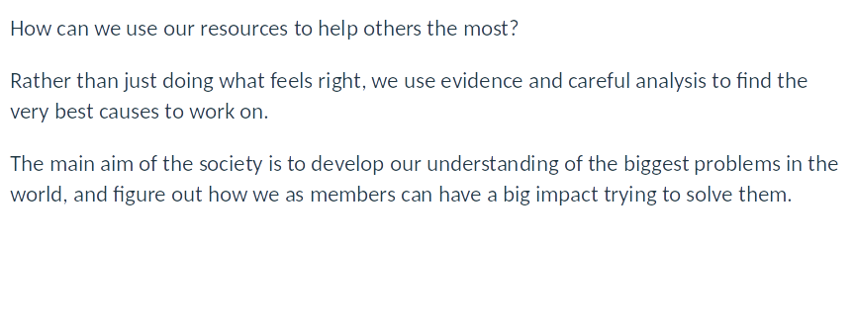

Slide 6
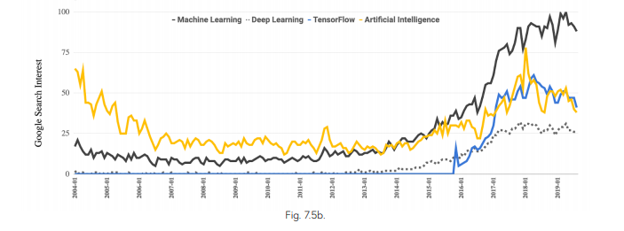
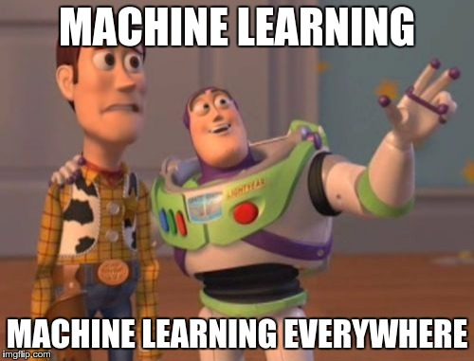
What is AI

Slide 7
AI time line
Statistics, 1988
Deep Blue beats Kasparov, 1997
AlphaGo via NN, 2016
ELIZA, 1966
Cats DL,
2012
Darthmouth, 1956
ImageNet, 2015
Self-driving cars, 2018
XCON, 1980
Internet, 1991
WATSON wins Jeopardy!,
2011

Slide 8
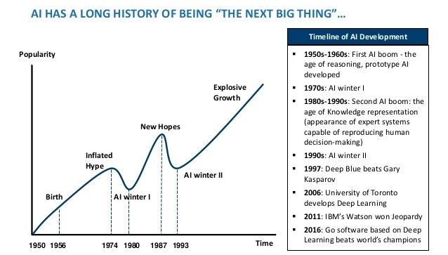

Slide 9
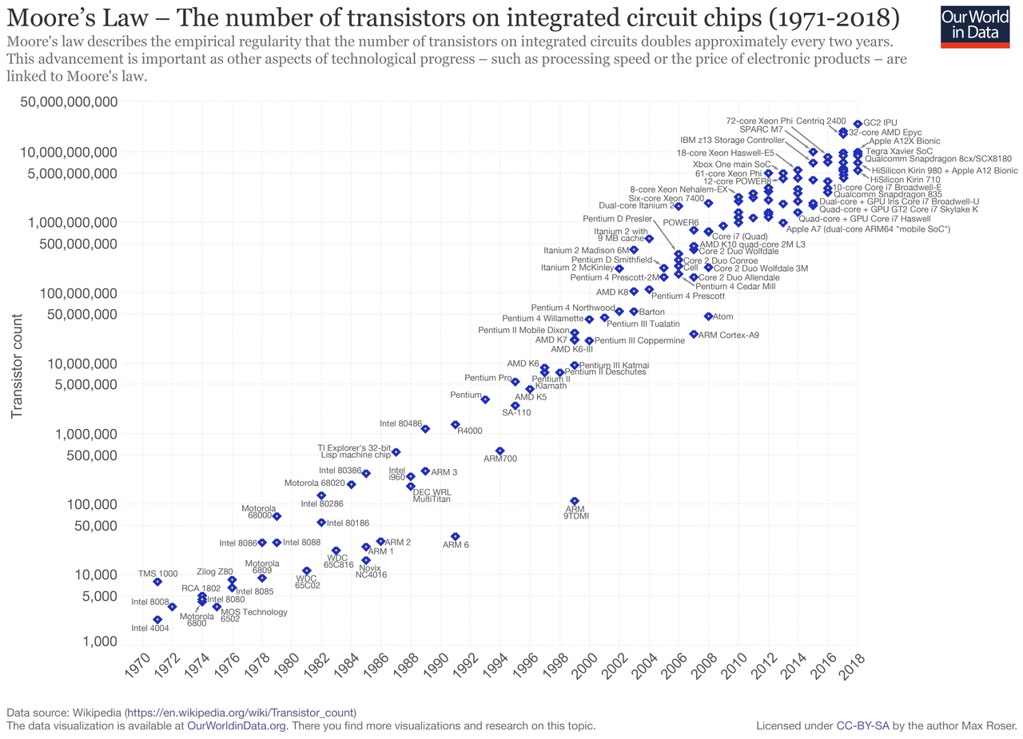
AI + Big data = Conquer the world
The number of transistors and resistors on a chip doubles every 24 months

Slide 10
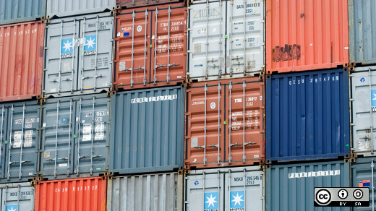
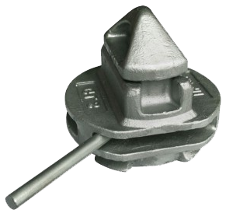
Twistlock 1950s

Slide 11
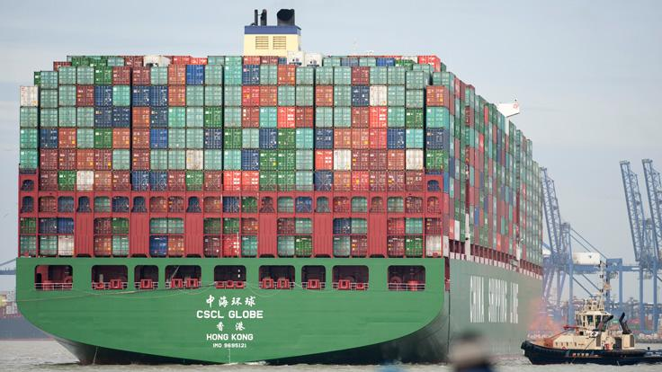

Slide 12
Discussion
Who is responsible for AI ?
How is artificial intelligence helping us today?
How would you like artificial intelligence to help you?

Slide 13
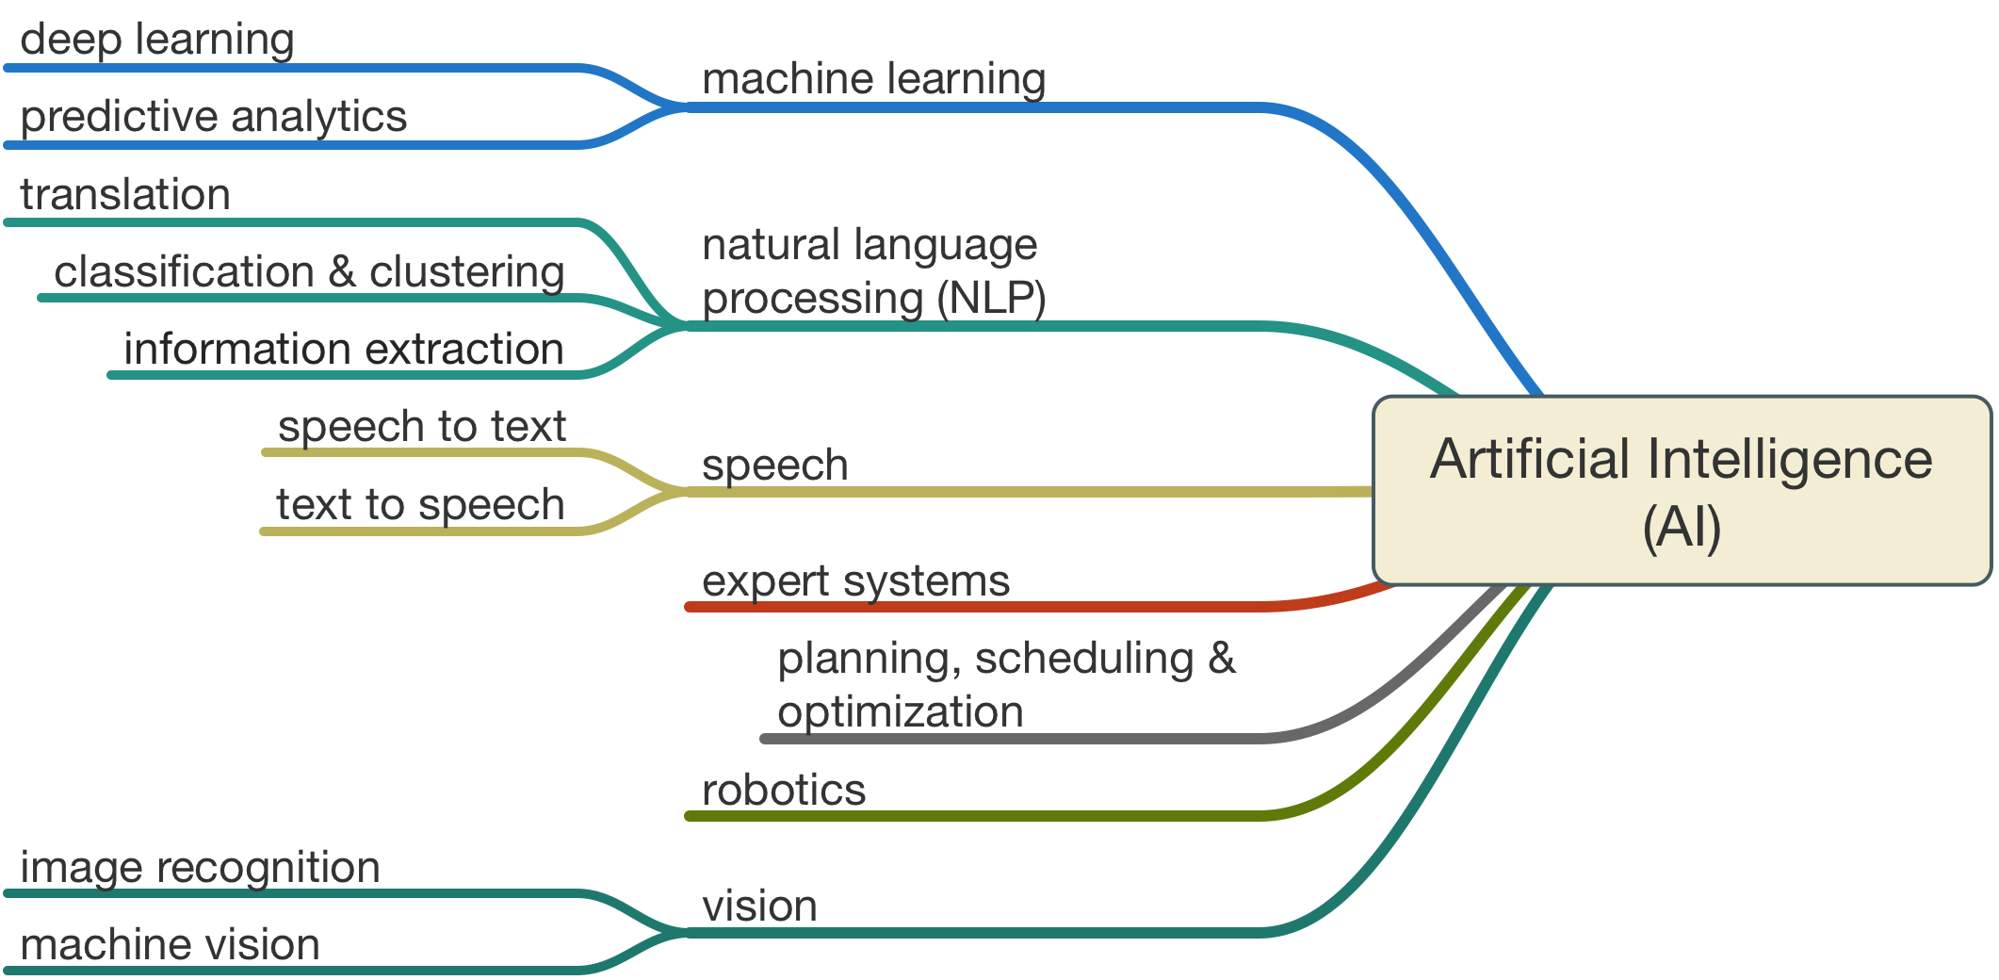
AI Landscape
General AI (AGI)
Narrow AI

Slide 14


Slide 15
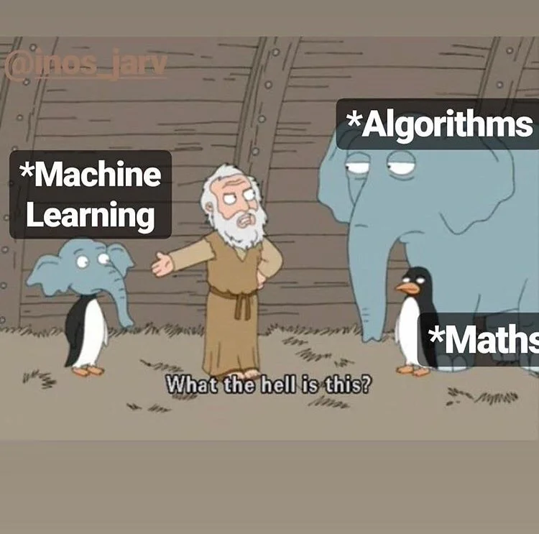
What is Machine Learning
Pattern recognition in data set
training on data for robust prediction
https://www.youtube.com/watch?v=HcqpanDadyQ

Slide 16
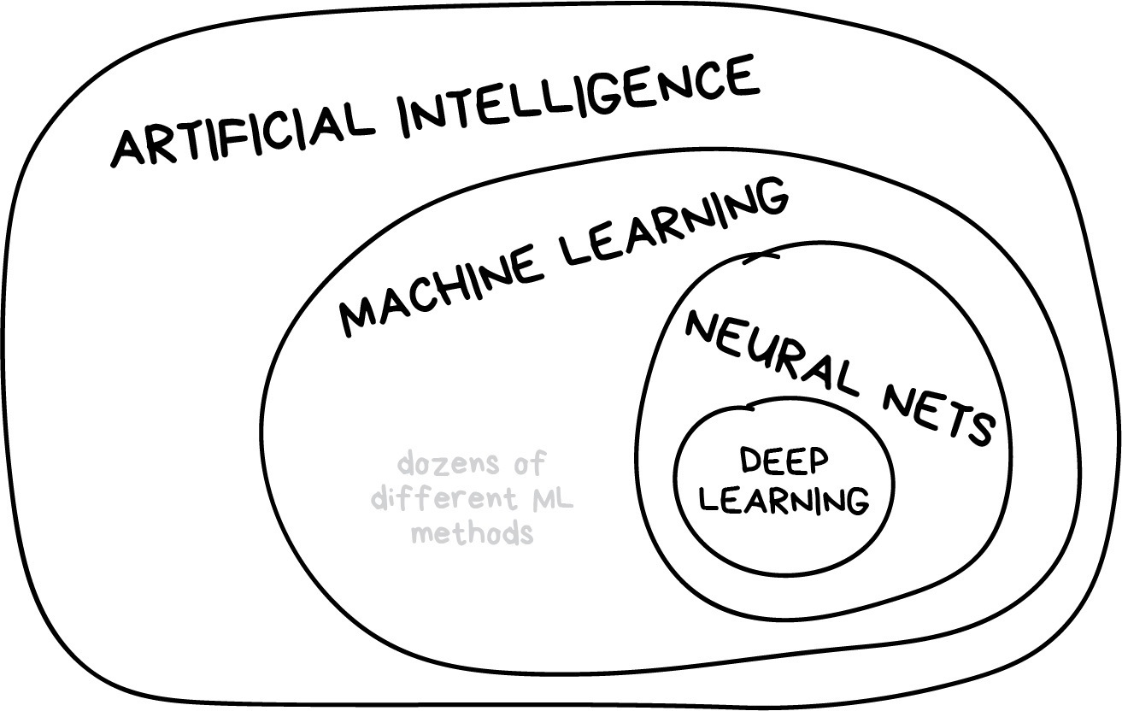
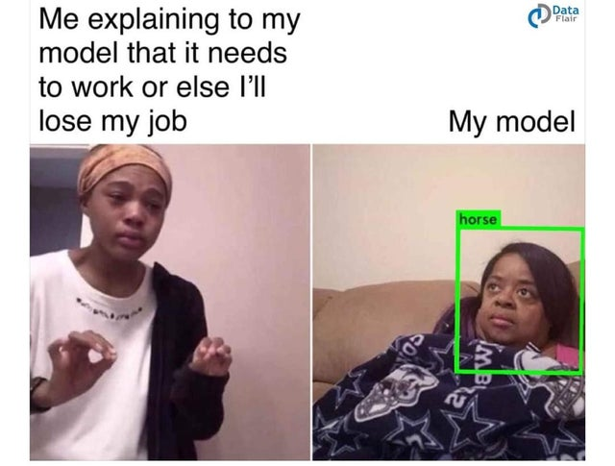
On Neural Nets and Deep Learning

Slide 17
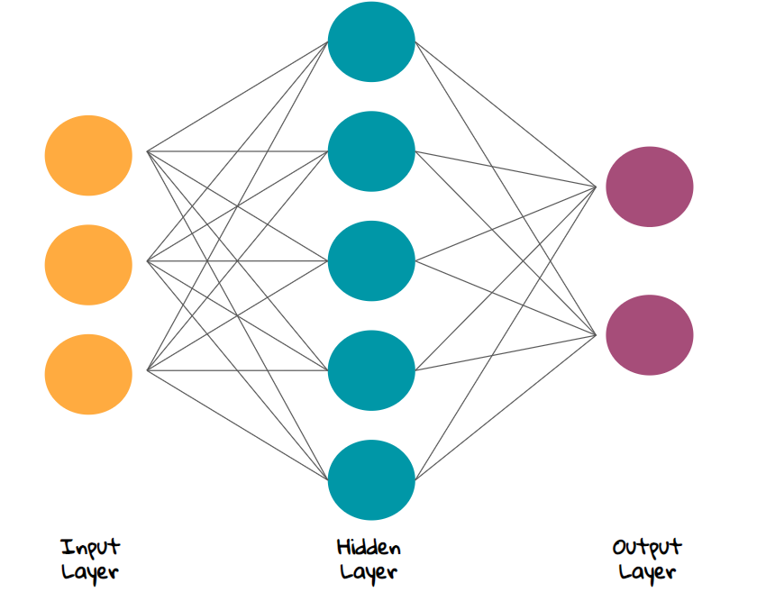
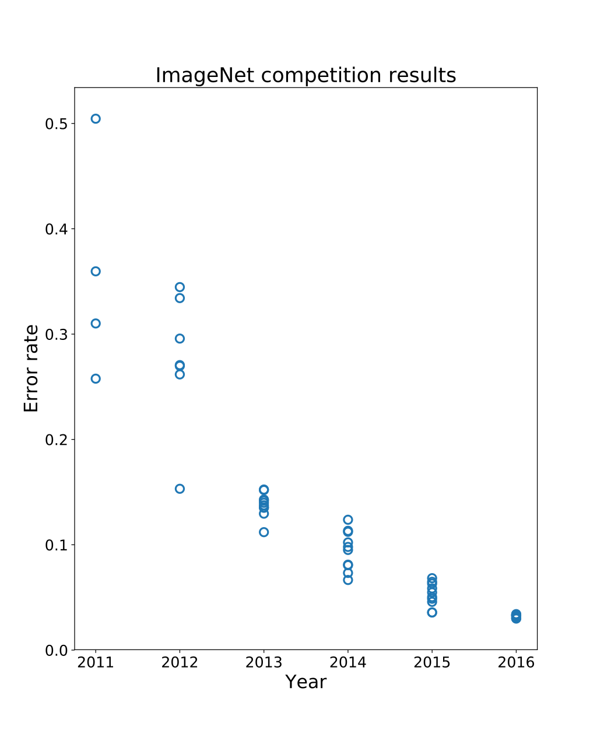
On Neural Networks and Deep learning
Alex Krizhevsky

Slide 18
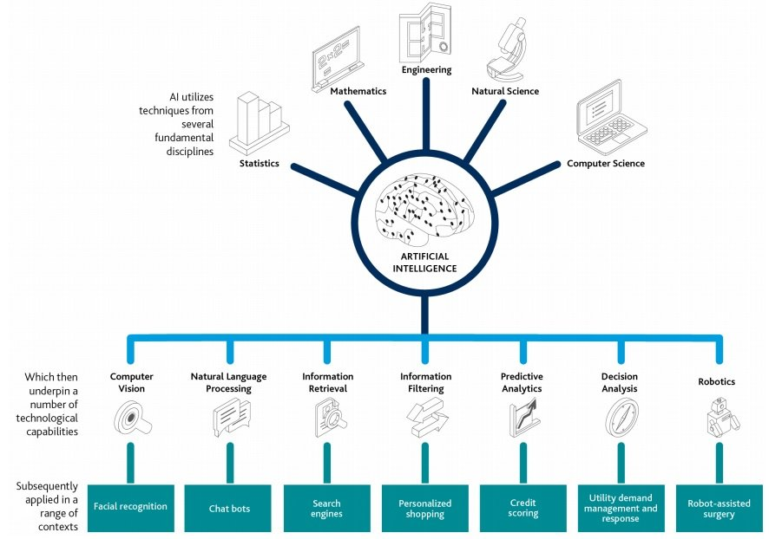
AI today

Slide 19
Progress of technology
https://www.youtube.com/watch?v=2svOtXaD3gg&t=192s Deep fake
https://www.thispersondoesnotexist.com/ Face generation via Deep Learning
https://www.youtube.com/watch?v=kopoLzvh5jY Evolutionary training
Robotics at Boston Dynamics

Slide 20
Discussion
Who benefits from AI ?
Have you read about an AI program not working as expected causing damage or even deaths?
Who decides how to deploy AI ?

Slide 21
AI risks

Slide 22
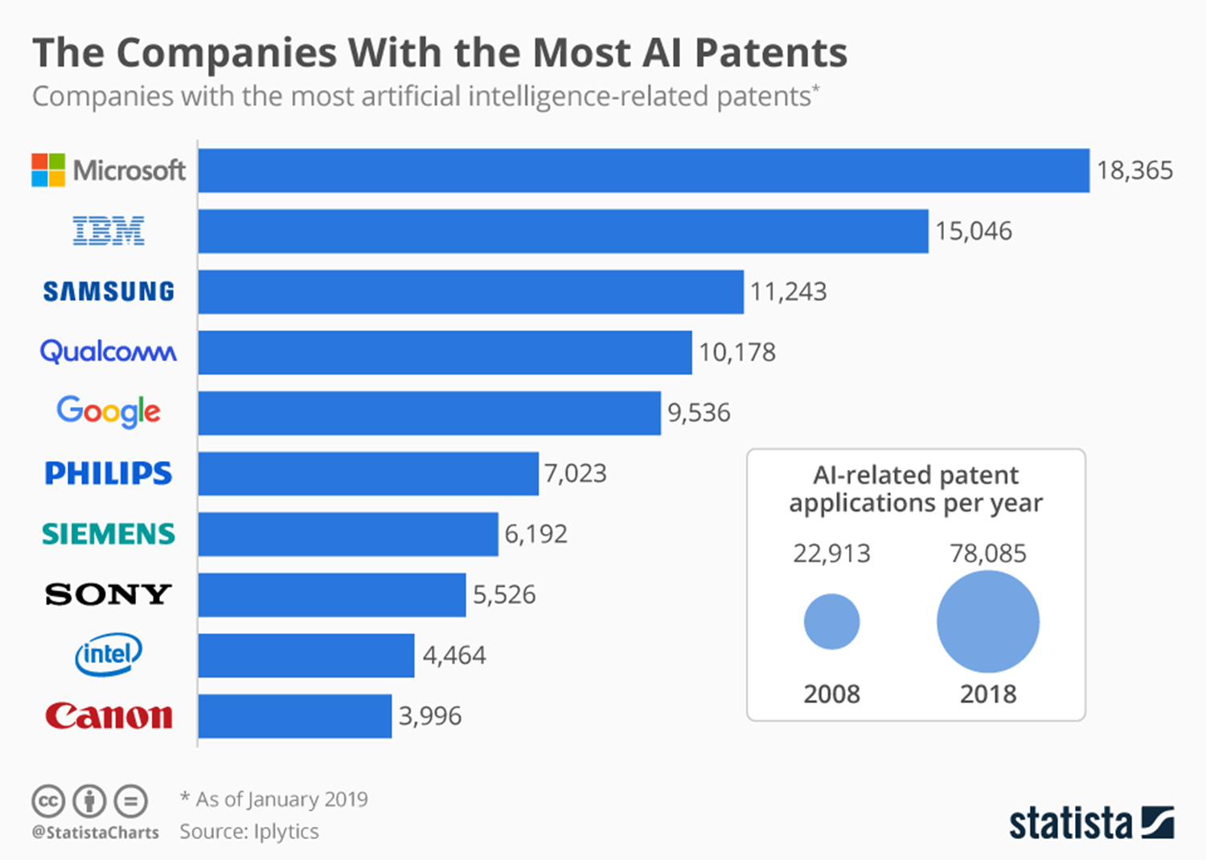
Centre of gravity -- policy ?

Slide 23
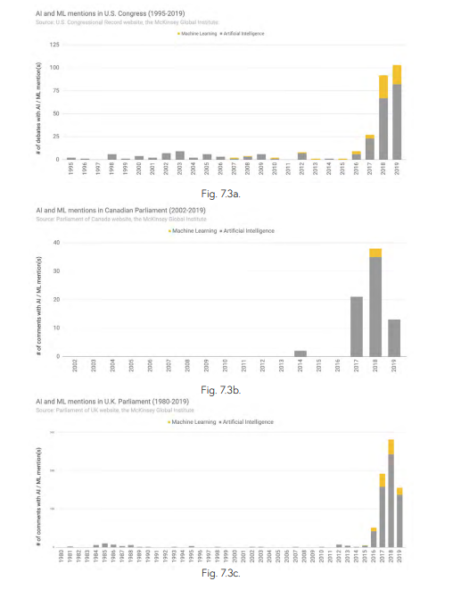
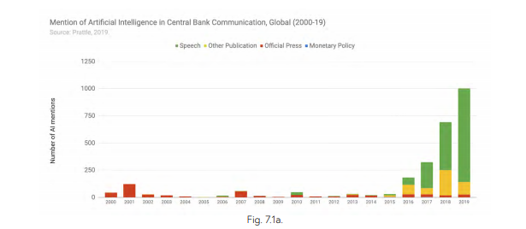
Politics is slowly catching up

Slide 24
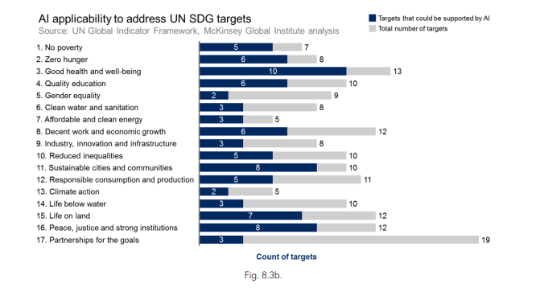
AI uses -- what about the risks

Slide 25
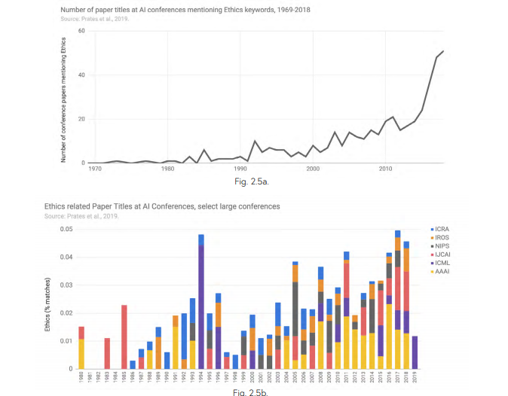
Debate is going

Slide 26
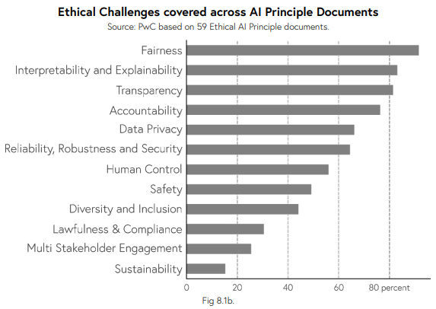

Slide 27
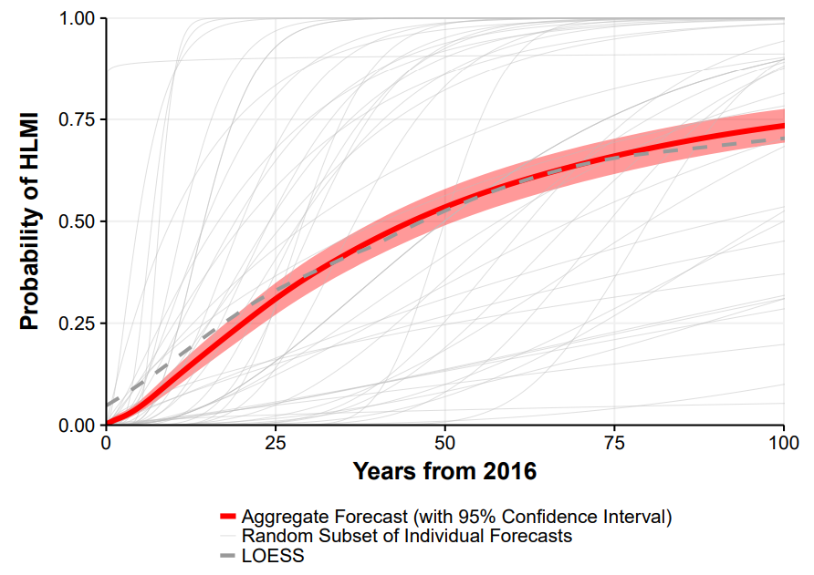
Future of AI

Slide 28
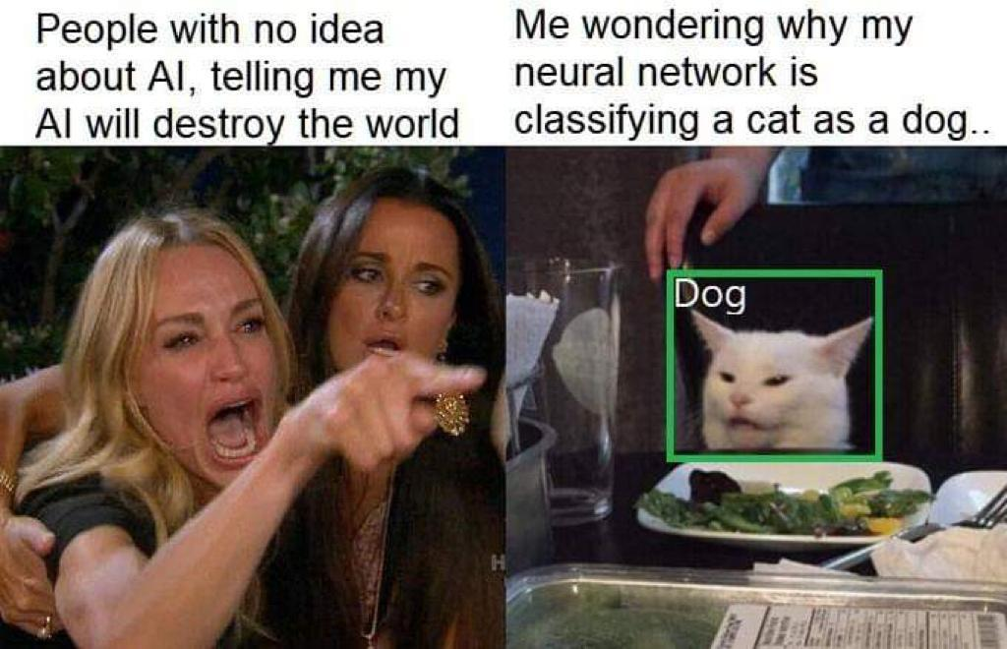
Discussion
How might our lives change if AGI were created and freely available tomorrow?
How do we protect Access to Ai from bad actors ?
Is bias fair ?

